Slide 1
Neural circuits for touch-induced locomotion in C. elegans
Nikhil Bhatla
January 9, 2013
MIT IAP

Slide 2
This is a C. elegans worm
2 mm
Adult hermaphrodite
Video speed is real-time

Slide 3
The connectome of C. elegans is known
Each worm has exactly 302 neurons,
with about 7,369 chemical synapses & 975 gap junctions
Schematic: Durbin 1986
Notes:
Number of neurons is fixed while there is a limited amount of variability in synapses from worm to worm, with the connectivity analyzed for 1-3 worms (depending on the part of the worm).
Data set is available over 400 pages spanning at least 3 papers, so it’s very difficult to access and query.
Moreover, just because there’s an anatomical connection between 2 neurons does not mean that there is a functional connection. So the dataset is useful for generating hypotheses, but you still have to test them with experiments.

Slide 4
A neural map of the C. elegans head
Only cell bodies shown (processes excluded)

Slide 5
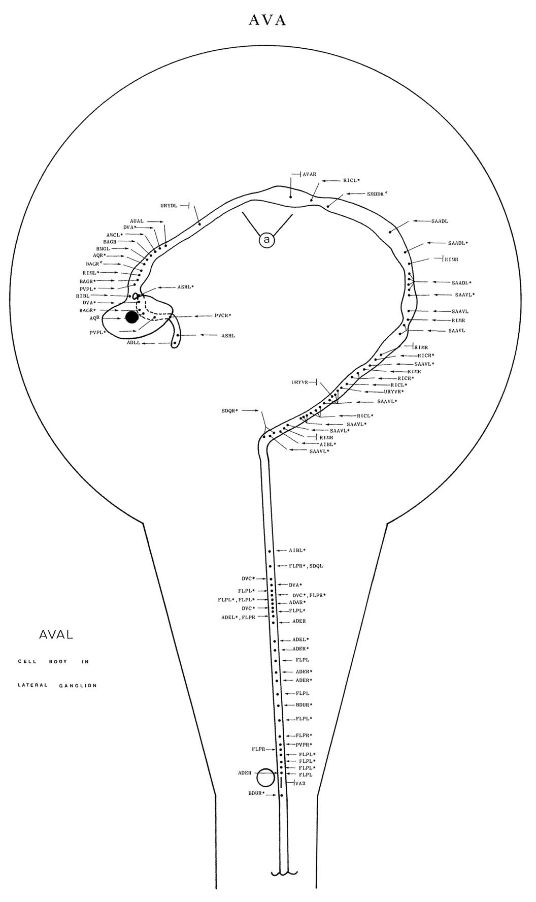
Connectivity map of AVA neuron
AVA ventral cord synapses (MoW Table Guide)
partners | gap junctions | synapses from | synapses to and corecipients
PVC | 10 | 3+11 m | 7, 5 LUA, 4 PVC, 4 DA8, 2 PDE, VA10, DB5, VA4, DB3, DA7, DA5
VA11 | 8 | - | 6 AS11, 3 DA8, 2 DA9, VA12, VA10, VD13
DA8 | 1 | - | 4 PVC, 3 VA11, 2 AS11, VA12, DA7, DA9, VA10, VD13
DA4 | 5 | - | 3, 4 DA3, 2 DA5, 2 VA3, VA4
VA10 | 2 | - | 1, 3 AS10, 2 DA7, PVC, VA11, AS11, DA8
DA5 | 5 | - | 2, 3 VA5, 2 DA4, PVC, DA6
DA3 | 2 | - | 2, 4 DA4, 2 DA2, VA3
AS11 | - | - | 6 VA11, 2 DA8, VA10
DA7 | 2 | - | 2 AVA, 2 VA10, AS10, DA8, PVC
VA5 | 6 | - | 3 DA5, VA6, AS6, DA6
LUA | - | 1 + 19 m | 5 PVC
DA9 | - | - | 2, 2VA11, DA8
AS5 | 2 | - | 3VA6, AVB
DA1 | 8 | - | 2, AVA, SABD
AS10 | 1 | - | 3VA10, DA7
VA4 | 3 | - | PVC, DA4, AS4, DB3
DA2 | 3 | - | 1, 2DA3, AVE
VA6 | 5 | - | 3AS5, VA5
VA3 | 3 | - | 1, 2DA4, DA3
AVE | - | 8+30 m | 2AS3, AS1, DA2
AVA | 4 | 3m | 2DA7, DA1
White..Brenner 1986

Slide 6
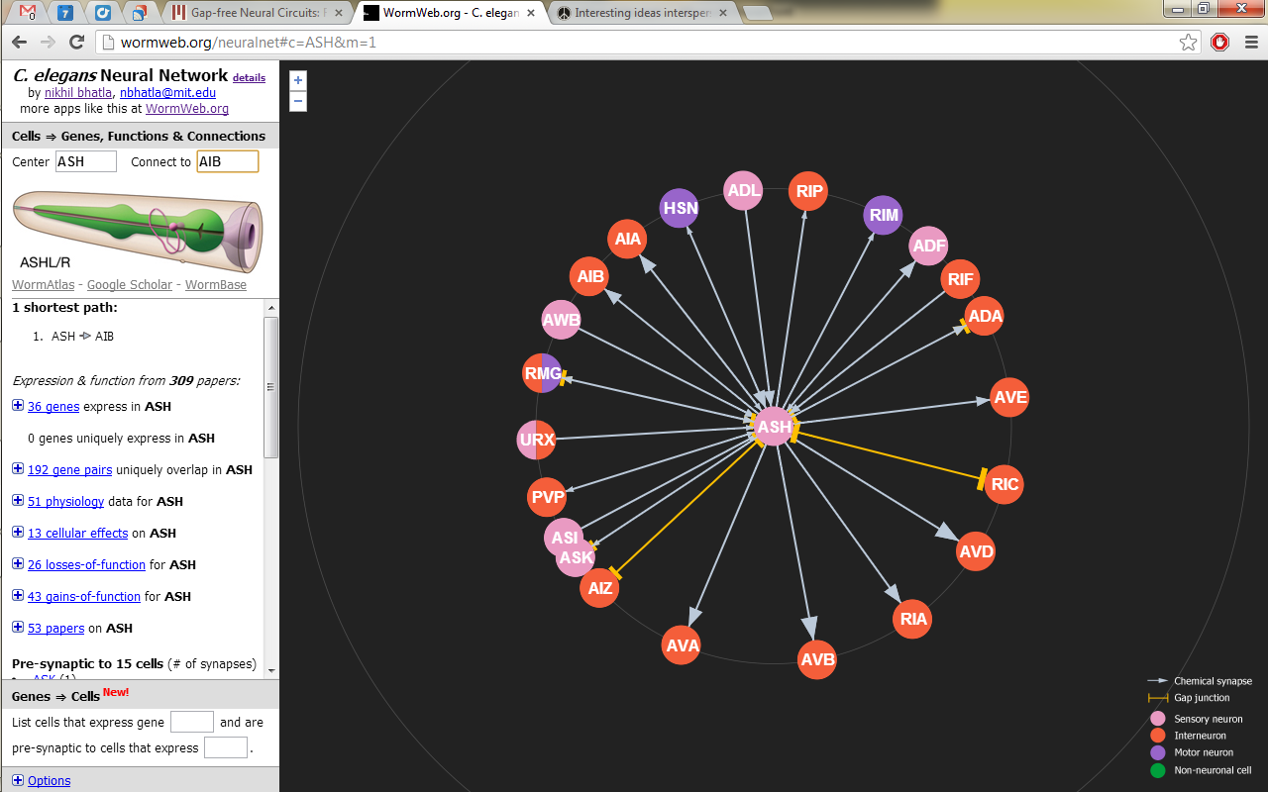
Interactive neural network browser
http://wormweb.org

Slide 7
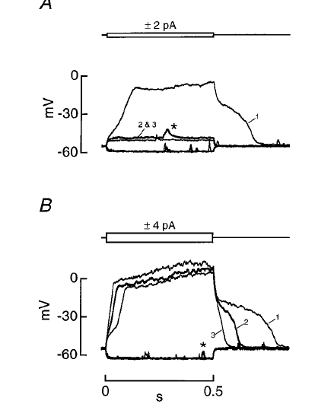
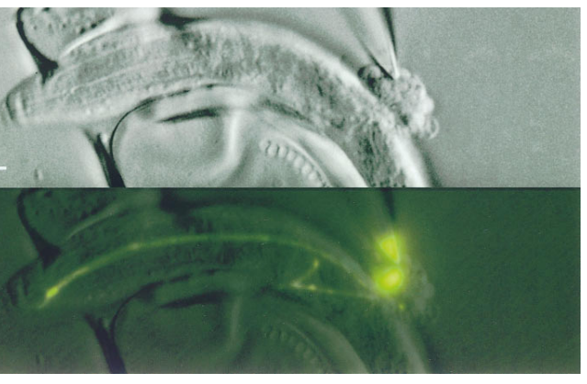
Non-spiking electrical activity of C. elegans neurons
Patch-clamp recording of ASER,
a sensory neuron for chloride
Goodman..Lockery 1998

Slide 8
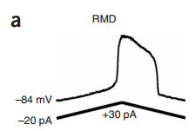
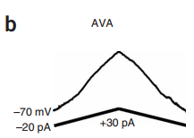
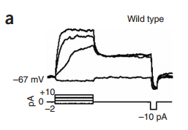
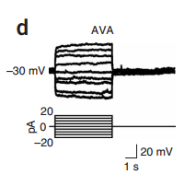
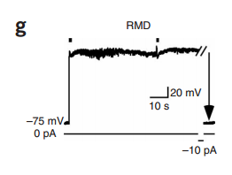
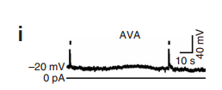
Non-spiking electrical activity of C. elegans neurons
plateau potential
graded potential
Responses to current:
Responses to glutamate (*):

Slide 9
C. elegans reverses with anterior gentle touch
Video speed is real-time
Li..Xu 2011

Slide 10
Identifying neurons for laser ablation
DIC optics:
arrows indicate neurons
Fluorescent view:
GFP specifically labels one of the neurons shown above

Slide 11
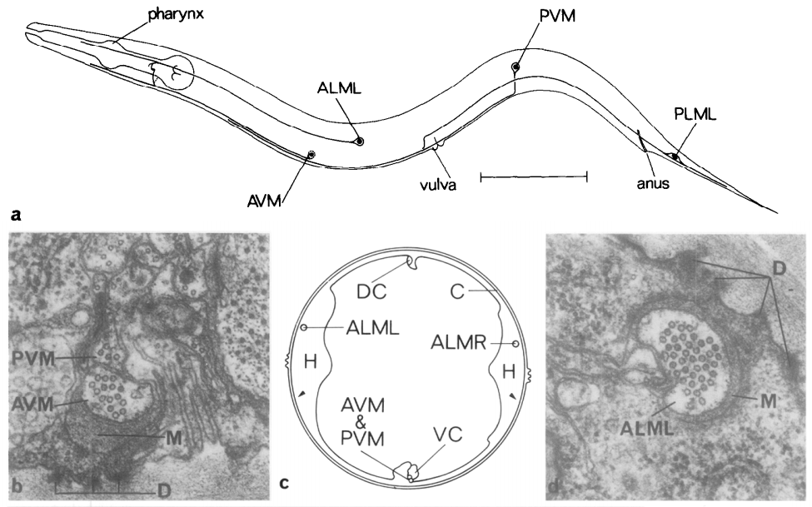
Anatomy of ALM, AVM and PLM neurons
Chalfie & Sulston 1981

Slide 12
Example of electrical synapse between AVM and AVD
electrical
Chalfie..Brenner 1985

Slide 13
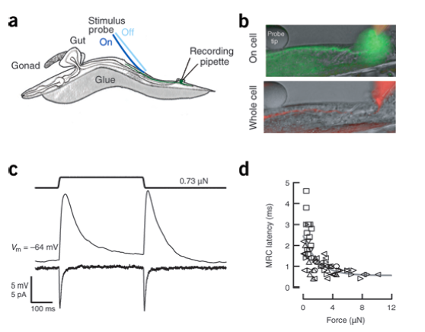
ALM and PLM respond to gentle touch
ALM
PLM
Suzuki..Schafer 2003, O’Hagan..Goodman 2005

Slide 14
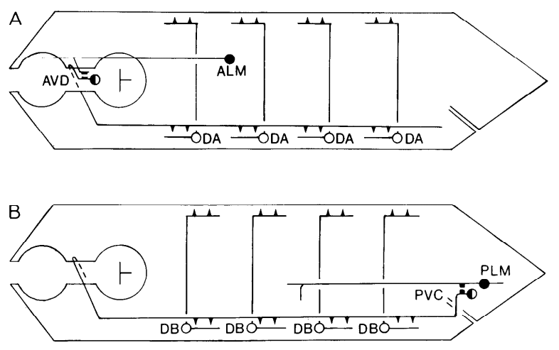
Anatomical structure of gentle touch circuit
Chalfie..Brenner 1985

Slide 15
MEC-4 mechanosensory channel localizes to neurite of AVM
MEC-4::GFP localizes to puncta along AVM neurite
Voglis & Tavernarakis 2005

Slide 16
C. elegans reverses after anterior harsh touch
Video speed is real-time
Li..Xu 2011

Slide 17
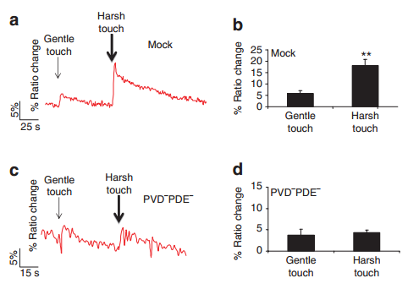
PVC neurons respond differently to gentle vs. harsh touch
PVC
Li..Xu 2011

Slide 18
Circuit for gentle touch: excitatory mix of electrical and chemical synapse
AVAs
ALMs
DAs
backward
locomotion
AVDs
anterior
touch
AVM
PLMs
PVCs
posterior
touch
DBs
forward
locomotion
AVBs

Slide 19
Circuit for touch-induced locomotion: gentle and harsh
stimulus
sensory
command
motor
behavior
BDUs
SDQR
AVAs
harsh
anterior
FLPs
ADEs
AQR
AVEs
gentle
anterior
ALMs
AVM
AVDs
DAs
backward
locomotion
gentle
posterior
PLMs
PVCs
DBs
forward
locomotion
harsh
posterior
PVDs
PDEs
DVA
trp-4
harsh
anus
PHAs
AVBs
PHBs
Derived from Chalfie..Brenner 1985, Li..Xu 2011

Slide 20
C. elegans reverse in response to nose touch
Video speed is real-time
Kindt..Schafer 2007

Slide 21
Nose touch depolarizes ASH and requires AVA, RIM and AIB
Ablations
Physiology
RIM
worm glued for electrophysiology
Piggott..Xu 2011

Slide 22
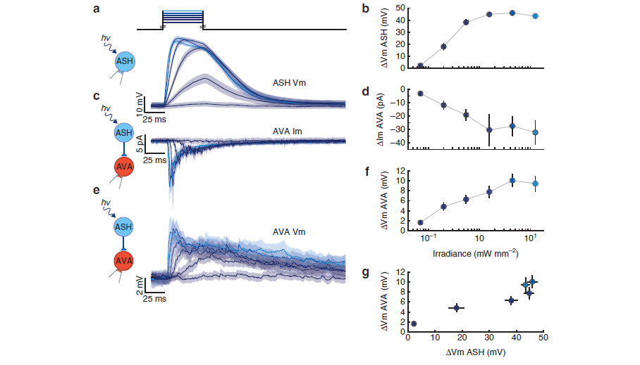
ASH activates AVA
Lindsay..Lockery 2011

Slide 23
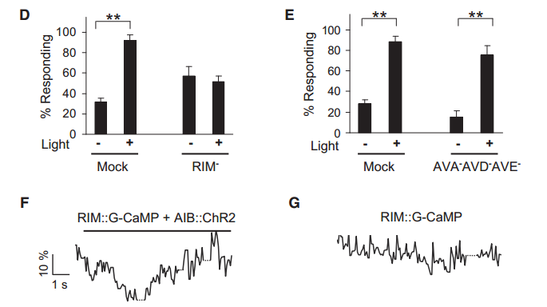
Ordering the neurons into a circuit
AIB is upstream of RIM
and in parallel with AVA/D/E:
Piggott..Xu 2011

Slide 24
Ordering the neurons in the circuit
AVA and RIM are likely
in parallel:
Piggott..Xu 2011

Slide 25
ASH releases glutamate onto AVA and AIB in response to nose touch
Post-synaptic glutamate receptor in AVA and AIB is glr-1
Piggott..Xu 2011

Slide 26
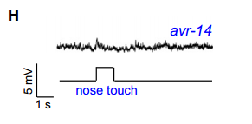
Nose touch stimulates AIB to release glutamate onto RIM
RIM
AIB
stim:
RIM
Piggott..Xu 2011

Slide 27
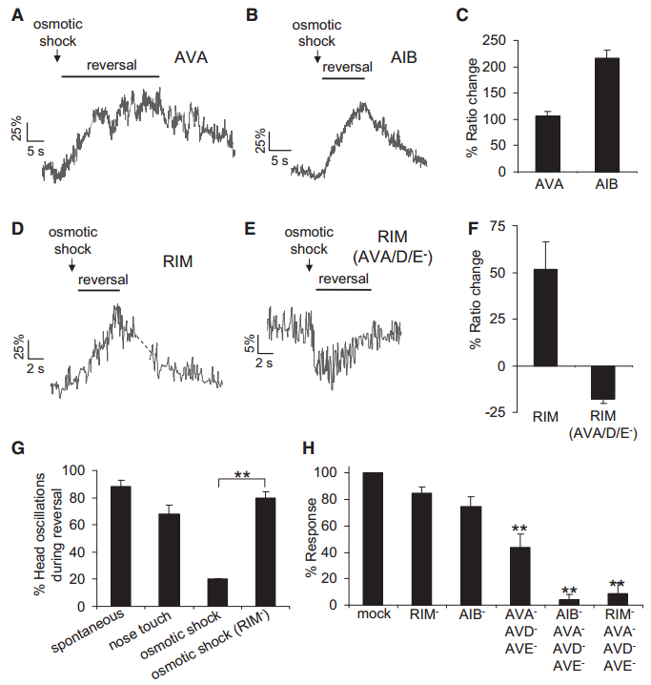
Osmotic shock is similar but different in its effect on RIM
Piggott..Xu 2011

Slide 28
Circuit for spontaneous and evoked reversals
AVAs
osmotic shock
GLR-1
AVEs
ASHs
AVDs
nose
touch
EAT-4
reversal
AIBs
RIMs
GLR-1
EAT-4
AVR-14
Derived from Piggott..Xu 2011, Kaplan & Horvitz 1993

Slide 29
All connections between these 4 neurons (from the connectome)
AVA
ASH
AIB
RIM

